Slide 1

Emerging Technologies
Session #11: App Administration
IBM Bluemix
The Digital Innovation Platform
Sylvain-Roch WILBERT
s_wilbert@fr.ibm.com
Université Paris - Dauphine

Slide 2
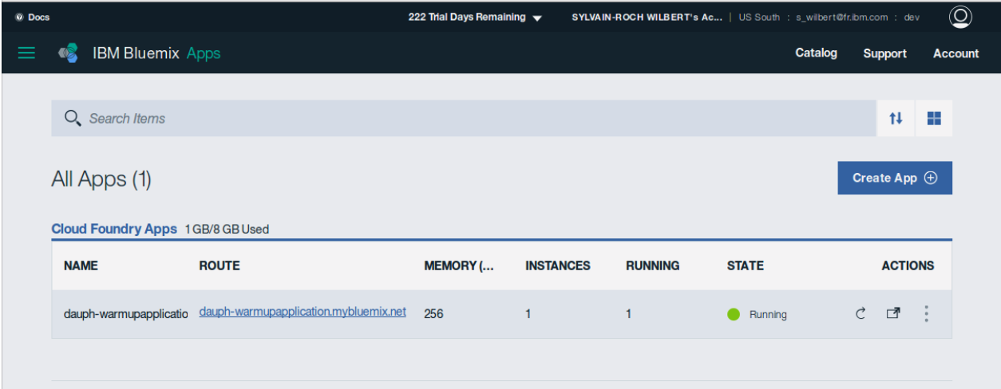
My application Health monitoring

Slide 3
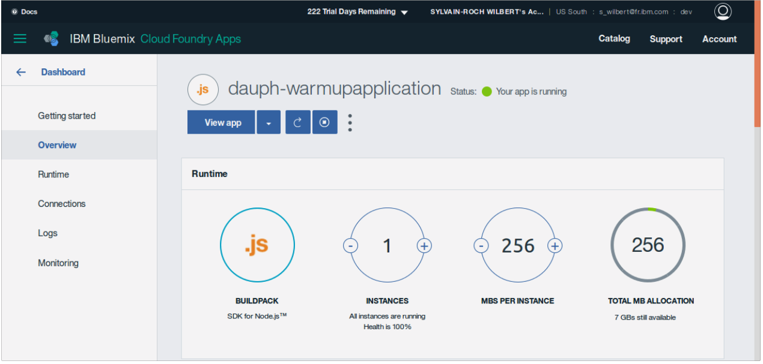
Managing my app From the Dashboard
Application
Start & Stop
Capacity Configuration
Add Services
Event Log
Availability

Slide 4
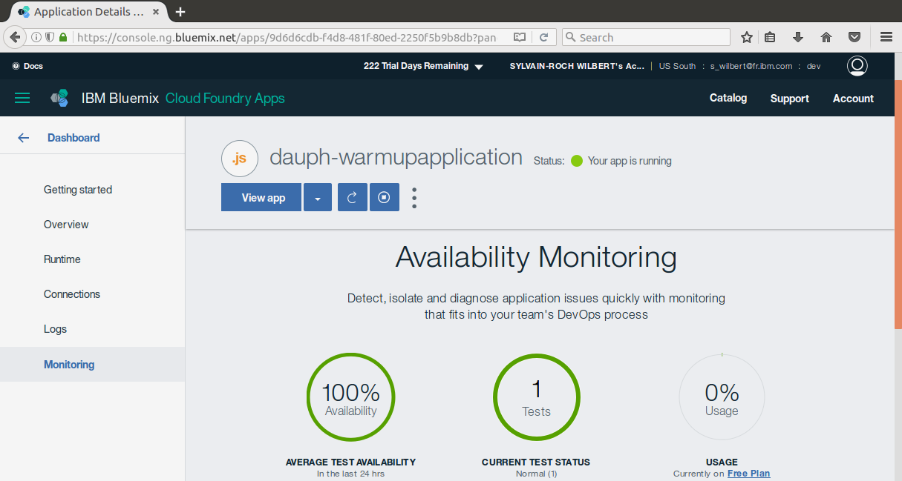

Slide 5
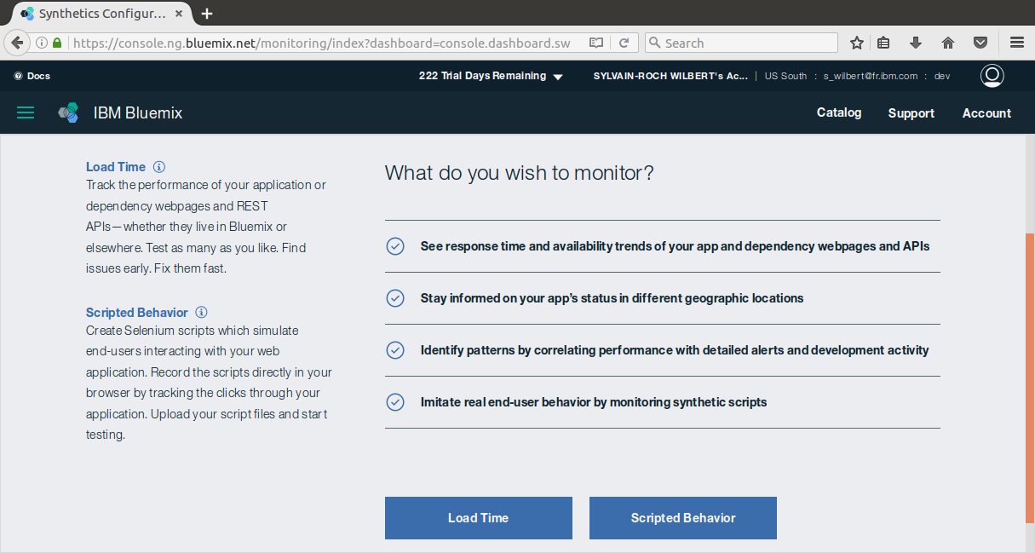

Slide 6
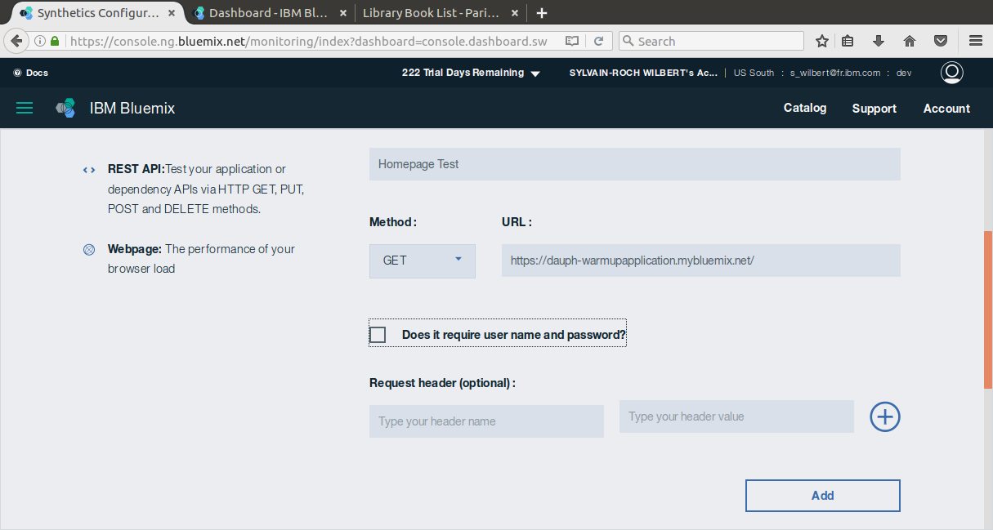

Slide 7
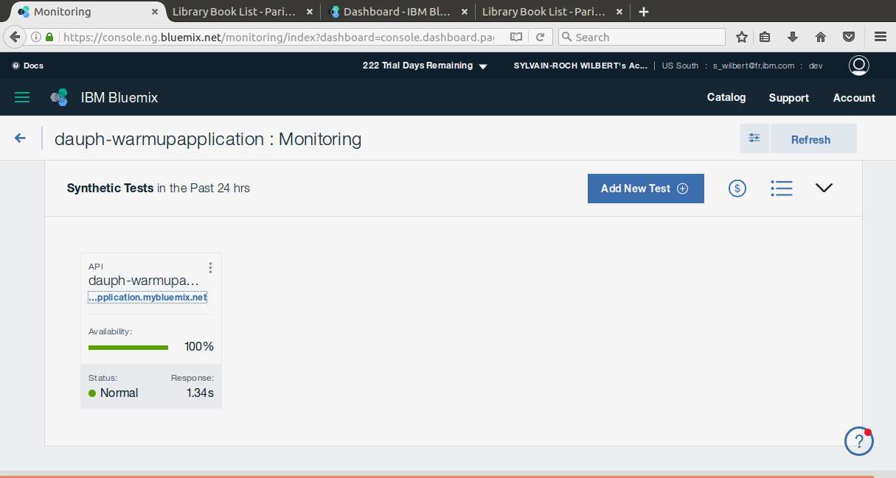

Slide 8
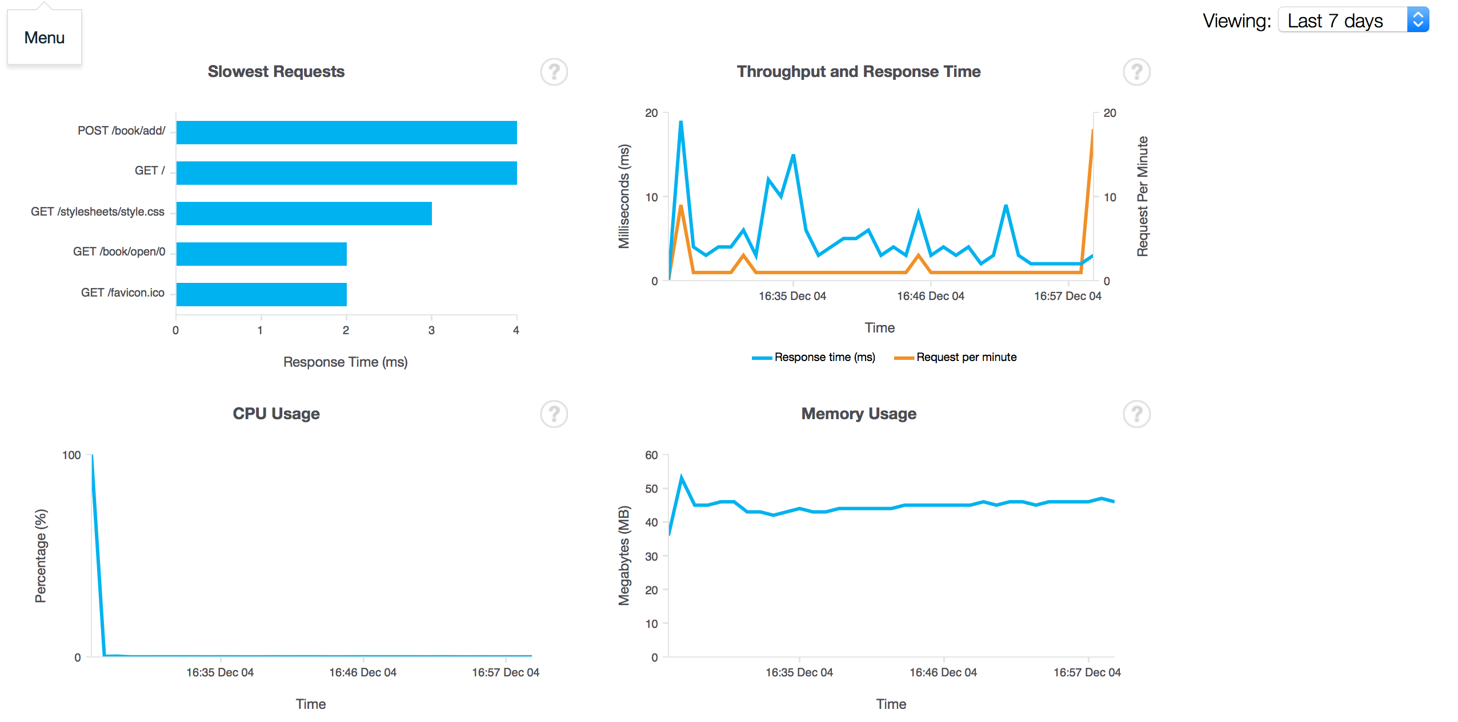
My application Health monitoring
« Come on… as an administrator, I want a detailed dashboard in order to see the App availability, Response Time…. so that I can truly manage my app ! This is what I want : »

Slide 9
My application Health monitoring
Exercize :
Find the right services in the catalog to perform application monitoring
Add it and connect it to you application.

Slide 10
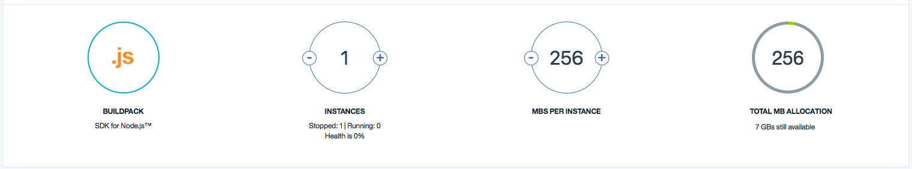
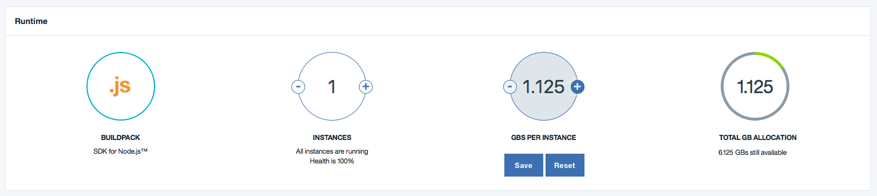
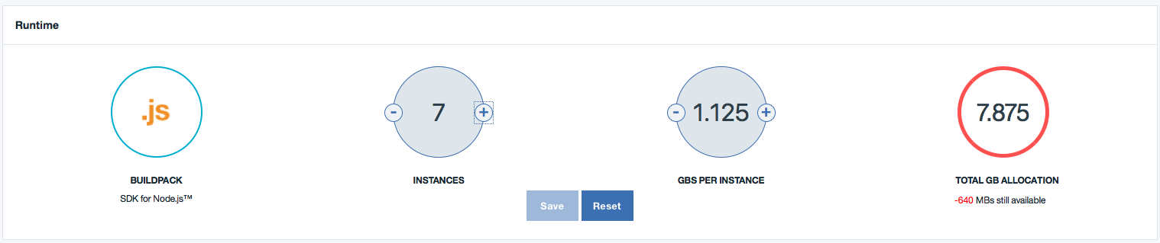
Adapting my platform to my needs

Slide 11
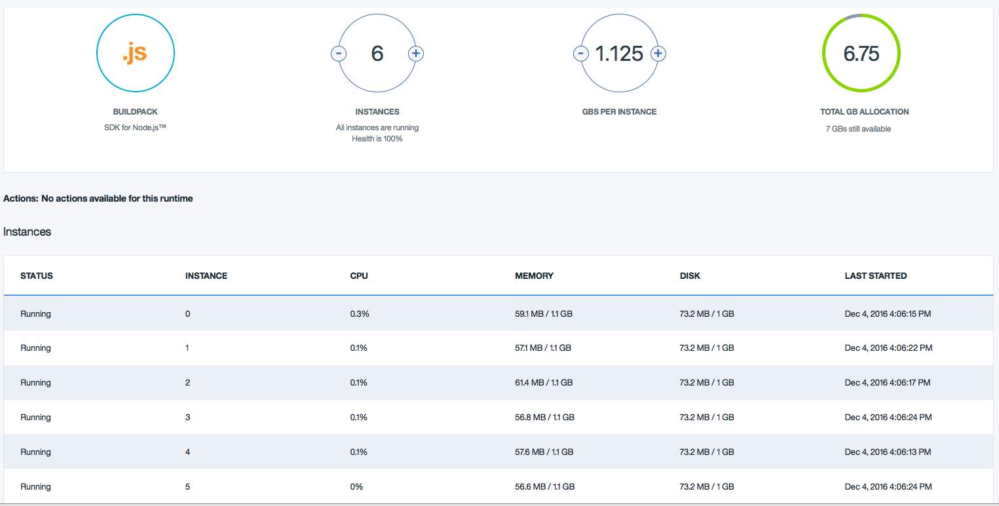
Highly parrallel, fed with Gigs of memory…

Slide 12
In a nutshell
Whaou, this is cool.
But what is the problem then ?

Slide 13
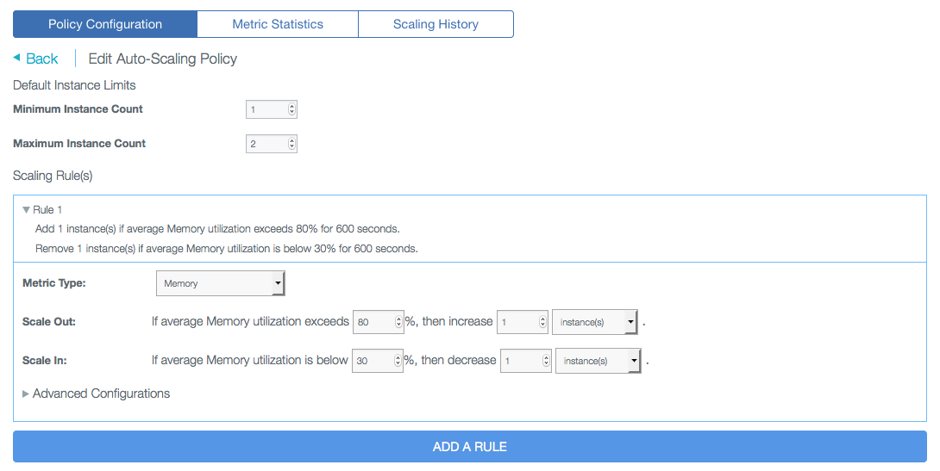
My application Capacity planning
« ok, but… as the hosting architect, I want an autoprovisionning tool in order to adapt the capacity to the usage so that the platform is automatically reshaped to the incoming workload! This is what I want : »

Slide 14
My application Health monitoring
Exercize :
Find the right services in the catalog to perform application autoscaling
Add it and connect it to you application.

